Slide 1
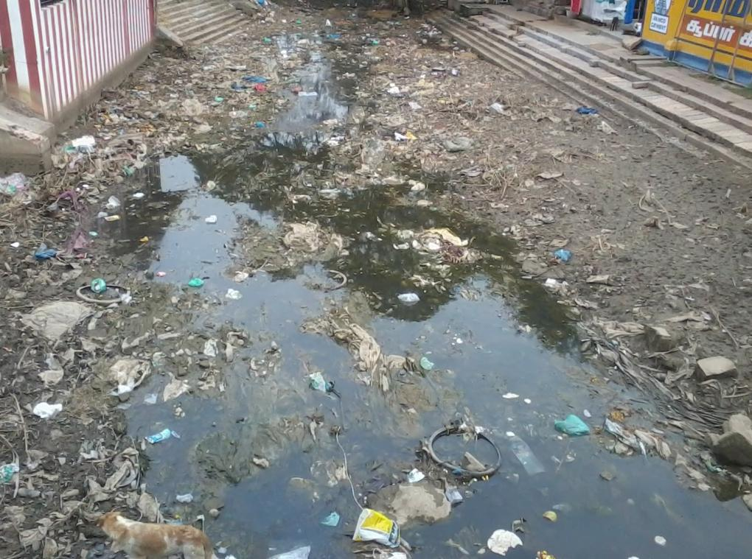
WATER POLLUTION
By
Dr. T. RAKESH SHARMA
Department of Environment and Herbal Science
Tamil University
Thanjavur

Slide 2
Learning Objectives:
Sources of water pollution
Causes of water pollution
Impacts of water pollution
Current Scenario of water pollution
Prevent and control of water pollution

Slide 3
Introduction
Water pollution is the contamination of water resources by physical, chemical, radioactive and microbial substances.
It happens when pollutants are directly or indirectly discharged into water resources.
It is a major global issue, leading to cause of diseases and deaths (14,000 people daily).
Mainly caused by anthropogenic activities in urban areas of developed and developing countries.

Slide 4
  Sources of Water Pollution
Point source - contaminants that comes from a single, identifiable source such as a pipelines or ditches.
e.g. Discharges from treatment plants, industries, and storm drains.
Non-point source – contaminates that comes from diffuse sources.
e.g. Agricultural and surface run-offs.

Slide 5
Causes of Water Pollution
Rapid growth of population, unplanned urbanization, increasing industrialization, rising of living standards and other human activities.
Sewage discharges from urban areas.
Solid wastes dump and littering plastics.
Effluents from various industries.
Agricultural and land run-offs.
Oil spills from tankers and ships.
High temperatures in natural water bodies
Lack of sanitation facilities.

Slide 6
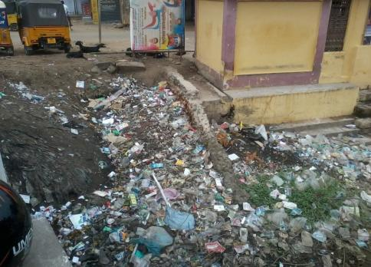
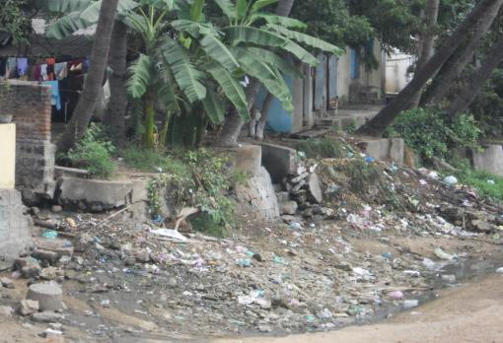
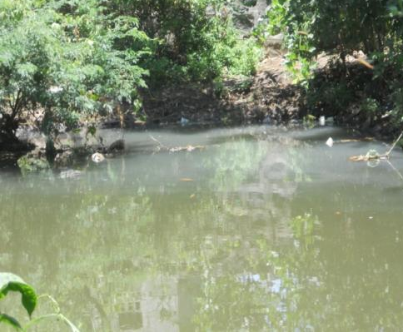
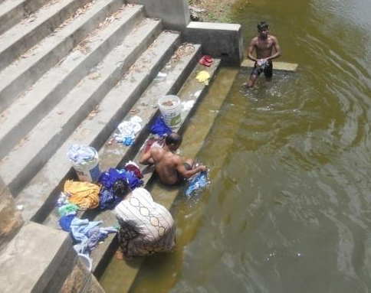

Slide 7
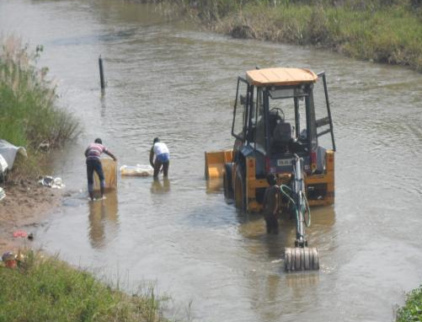
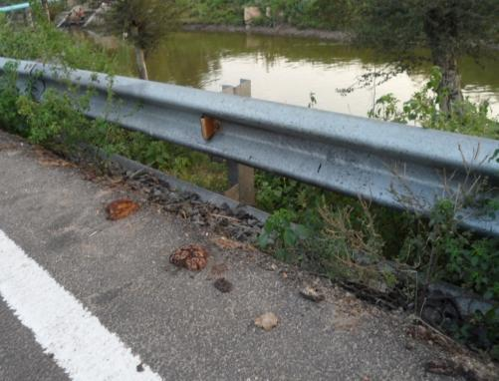
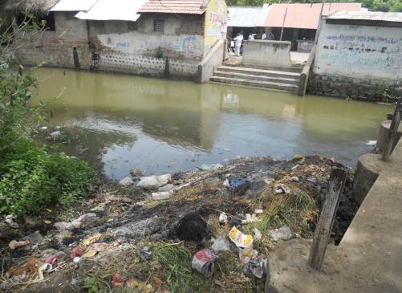
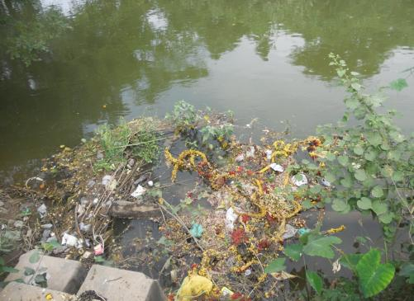

Slide 8
Effects of Water Pollution
Sewage and agricultural run-off are increasing the growth of algae, which causes the depletion of DO and finally leads to eutrophication.
Consumption of contaminated water cause water-borne-diseases (typhoid fever, cholera, malaria, dysentery and Hepatitis).
Swimming in contaminated water causes skin rashes to children.
Aquatic ecosystems are destroyed by the high temperature in surface waters and causing an ecological imbalance.

Slide 9
Some Facts of Water Pollution
In every year, 14 billion pounds of garbage is dumped into the ocean.
Ganges river is most polluted rivers in the world - discharging untreated sewage from 114 cities.
According to EPA, 1.2 trillion gallons of wastewater is discharging into U.S. water bodies annually.
Contaminated water is being consumed by 700 million people and more than 3,000 children die (UNICEF) in every day at global level.

Slide 10
Conti….
In India, only 12% of people get clean drinking water, the rest 88% consumed from polluted water bodies.
Aquatic organisms are decreased - five times more than terrestrial organisms.
Over 30 billion tons of sewages are discharged into water resources every year.
The massive oil spill in the Gulf of Mexico that was caused by British Petroleum caused over 1,000 animal species die.

Slide 11
Control of Water Pollution
Always conserve water
Practice organic farming
Dispose trash properly
Proper wastewater treatment and management
Primary treatment – Screening, grit removal, scum removal neutralization & sedimentation
Secondary treatment - Aerobic process & Anaerobic Process
Tertiary treatment – SF, ACF, electrolysis, Ion-exchange, RO, Disinfection methods
Cooling towers & cooling spray ponds

Slide 12
Summary
Different identifiable and diffused sources
Various human activities causing water pollution
Impacts to aquatic ecosystems and humans
Prevent water pollution and wastewater management

Slide 13

CopyRight – All Rights Reserved @ tamiluniversity.ac.in

Slide 14
THANK YOU

